Slide 1
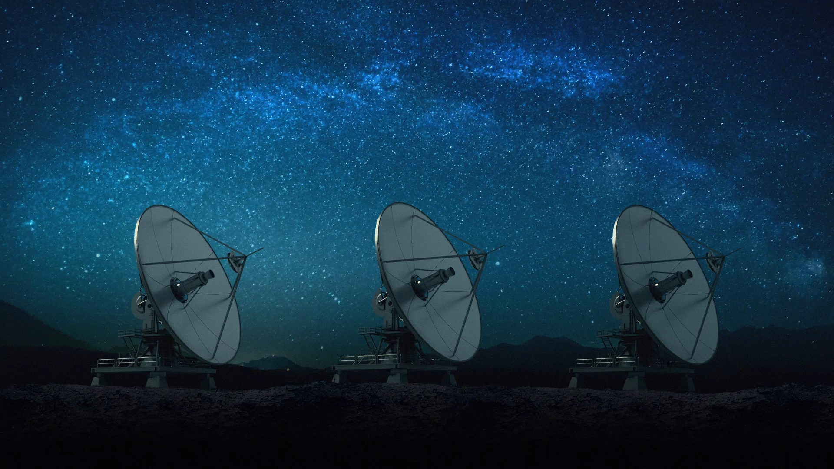
Electromagnetic Spectrum Usage by Satellites
Tashi Hatchell (Alexander)
DDI-12

Slide 2
Research Question/Objective
Objective:
Analyze how different satellite missions use the electromagnetic spectrum – highlighting which frequency bands are most common and which mission types are most dependent on specific bands.
Background
Working in an EW Delta
How it Addresses a Specific Problem or Question

Slide 3
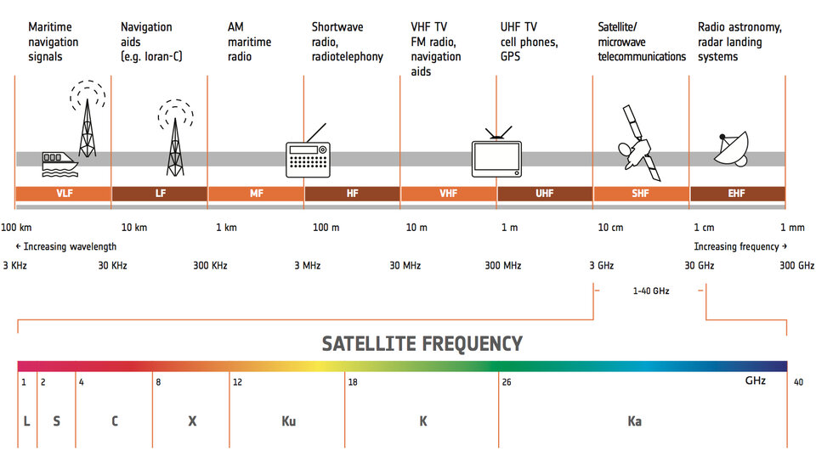
Background Information
Frequency Band Proxy Mapping
Mission Purpose | Typical Frequency Band | Examples
Communications | C, Ku, Ka
Earth Observation | X, S
Navigation | L
Meteorological/Weather Monitoring | S, X
Space Observation
Space Science
Technology Development
Electromagnetic Spectrum
Frequency Bands
Frequency Band Proxy Mapping

Slide 4
Data Sources & Transformations
Where Data Comes From, Reliability, Limitations
Summarize Cleaning and Transformation Steps in Non-Technical Way
Notes:
Limitations – Purposes weren’t just narrowed down to one category
‘Other’ includes Earth Science, Educational
Assumptions: First Mission in List was Primary Mission

Slide 5
Contextual Visualizations
Bar Chart (Satellite Missions by Frequency Band)
X = Mission Purpose
Y = Number of Satellites
Satellites By Country [in Each Orbit]?

Slide 6
Stacked Bar Chart (Comparing Mission Types Across Multiple Bands)
X = Mission Purpose
Stacked = Frequency Bands
Heatmap (Correlations Between Mission Type and Orbit Type)
Rows: Mission Purpose
Columns: Orbit Type
Color Intensity: Number of Satellites

Slide 7
Key Insights & Recommendations
Vulnerabilities

Slide 8
Future Areas of Research
Bands that are susceptible to space weather/solar activity

Slide 9
Contact Info

